Slide 1
Hydrogen Valleys (small-scale)
TOPIC ID: HORIZON-JTI-CLEANH2-2022-06-02
https://ec.europa.eu/info/funding-tenders/opportunities/portal/screen/opportunities/topic-details/horizon-jti-cleanh2-2022-06-02
Version due to 06/01/2022

Slide 2
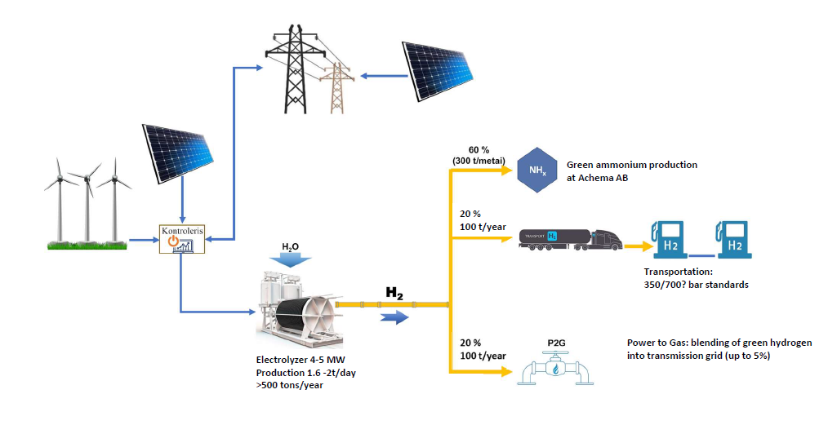
Bendras konceptas
Could be one player with 100 t/y H2 consumption

Slide 3
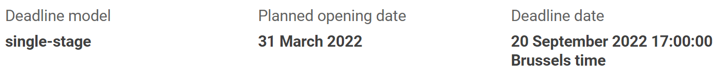
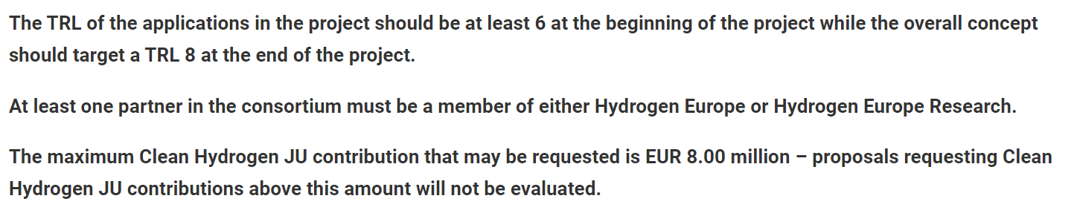
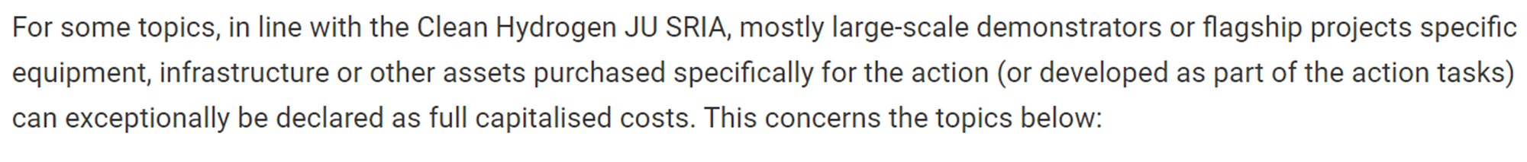

Slide 4
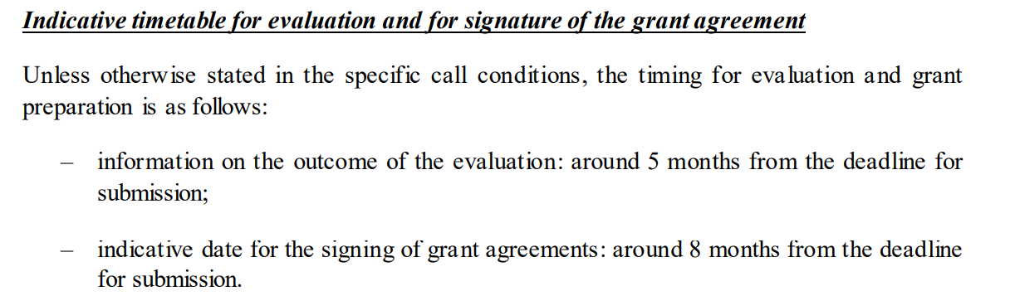
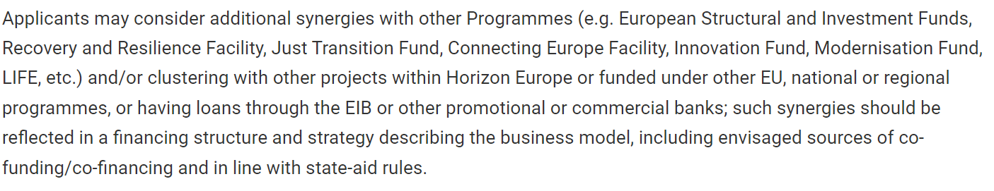

Slide 5
WP example:
Technological:
WP 1 - Project Management (LEI)
WP 2 –Hydrogen for Industrial Applications (leader: Achema)
WP 3 – Hydrogen for Energy Applications (leader: AmberGrid? LEI?; LT)
WP 4 – Hydrogen for Mobility Applications? Stakeholders? (leader:?; participants: Kautra?, Kauno autobusai?, Elinta?)
Social science:
WP 5 – In-depth linkage (leader: VDU, LT)
WP 6 – Impact Assessment (leader: Deloitte Espana, Spain)
WP 7 – Dissemination, Exploitation and Replicability of results (leader: Innotrope SASU; France)

Slide 6
Stakeholders (under discussions)
Kaunas?;
Vilnius?;
Klaipėda?;
Utena?.
Ukmergės?
Panevėžys?
5. LPK?
6. Susisiekimo ministerija?
7. Energetikos ministerija?
8. Ekonomikos ir inovacijų?
7. Klaipėdos nafta?
8. Latvenergo?

