Slide 1
Fuel Cells and Hydrogen Undertaking (H2020)
European Partnership on Clean Hydrogen (Horizon Europe)
2014-2020

Slide 2
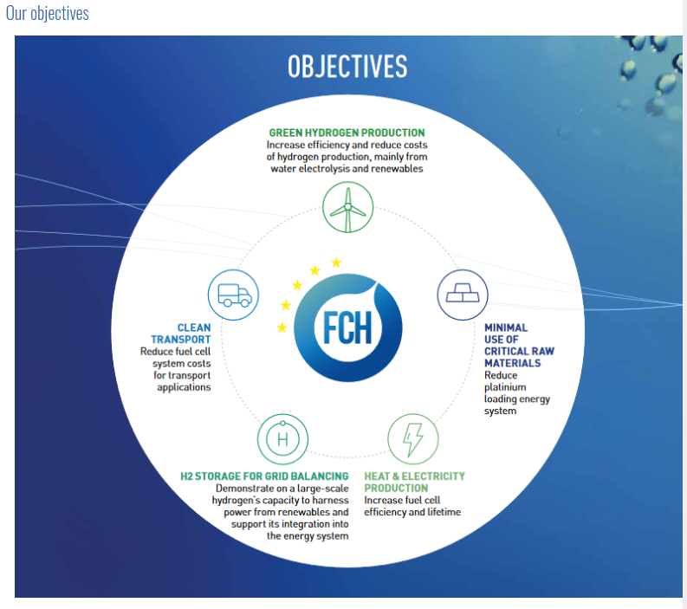
Our mission
At Fuel Cells and Hydrogen Undertaking (FCH JU), we are working to facilitate the market introduction of FCH technologies in Europe and realise their potential in a carbon-clean energy system. We do this by implementing an optimal research and innovation (R&I) programme in order to develop a portfolio of clean, efficient solutions that exploit the properties of hydrogen as an energy carrier and fuel cells as energy converters, to the point of market readiness.

Slide 3
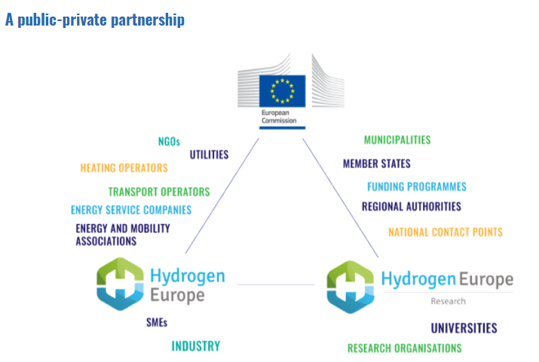

Slide 4
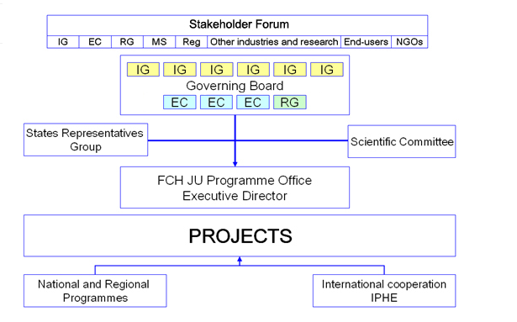

Slide 5
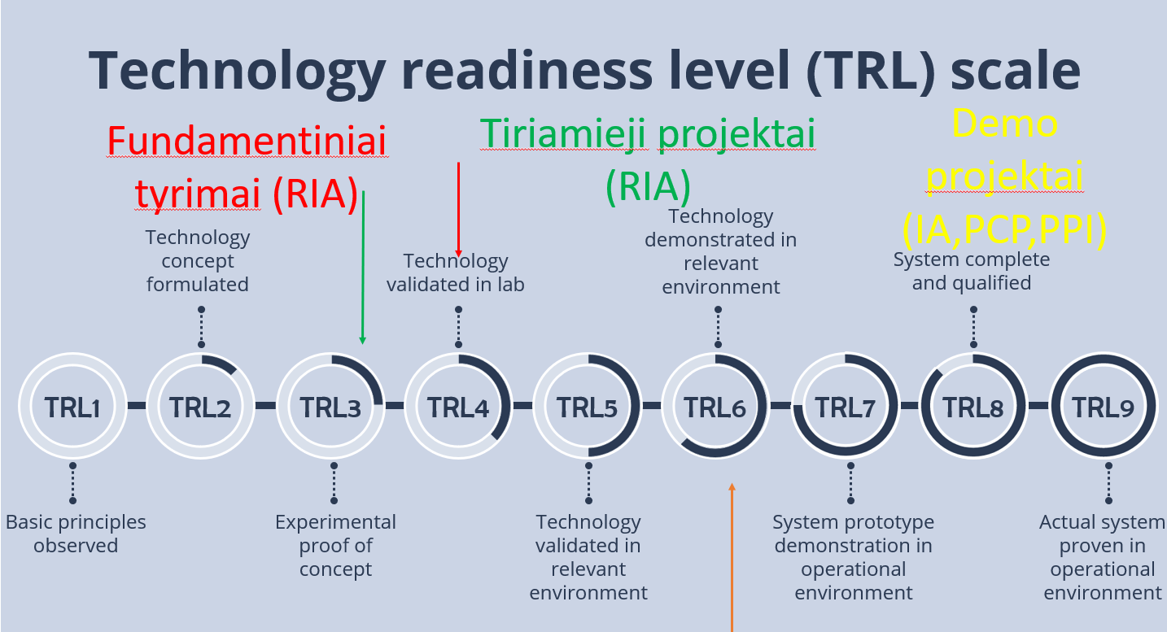
Finansuojamų projektų TRL

Slide 6

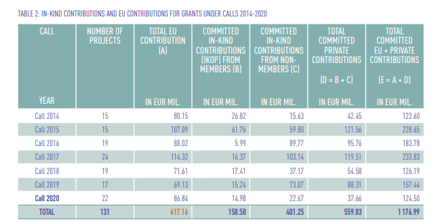

Slide 7
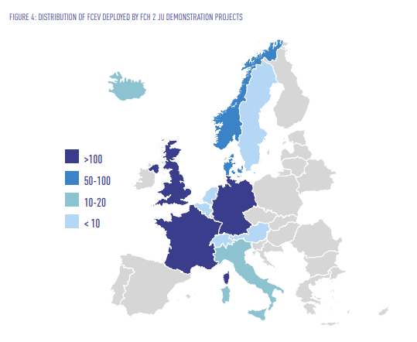
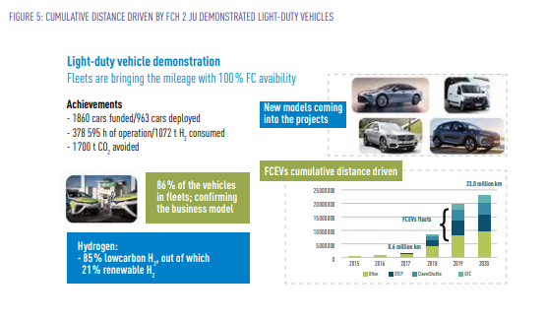
Projektai: transporto sektorius
https://www.fch.europa.eu/sites/default/files/FCH-20-001-Annual%20report%202020%20%28ID%2011531857%29.pdf.pdf

Slide 8

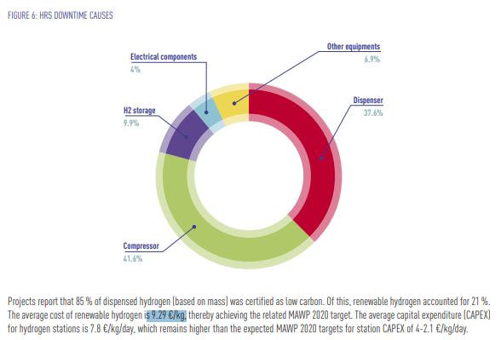
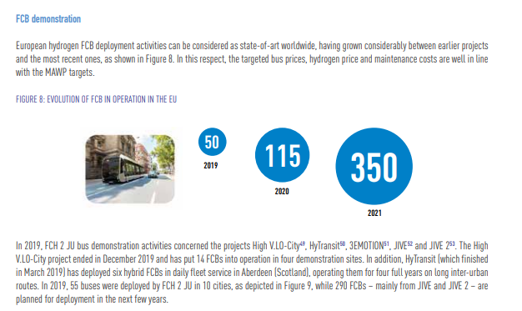

Slide 9
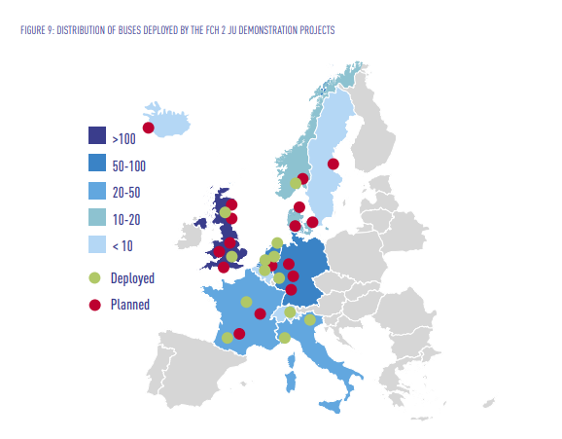

Slide 10
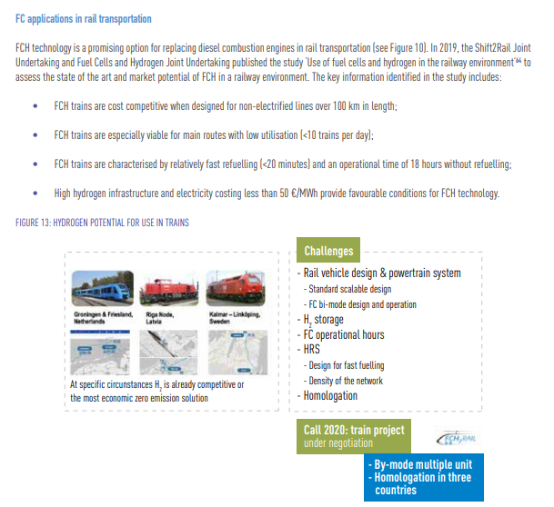

Slide 11
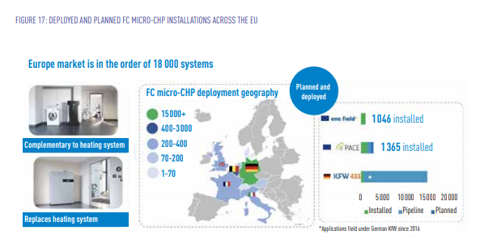
Projektai: šilumos ir elektros gamyba

Slide 12
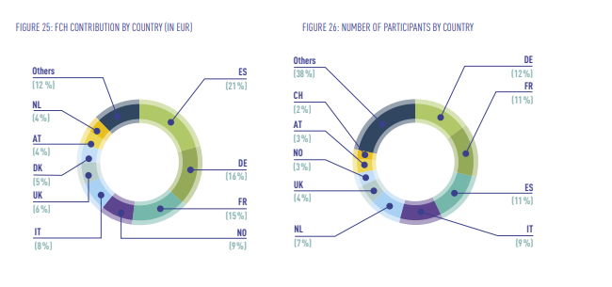
Projektų dalyviai

Slide 13
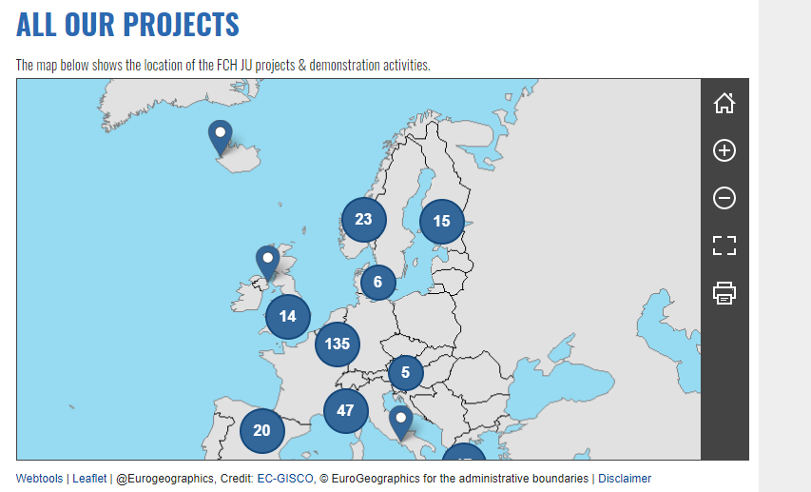

Slide 14

2021 - 2027

Slide 15
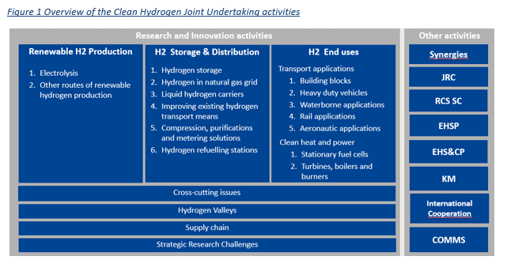

Slide 16
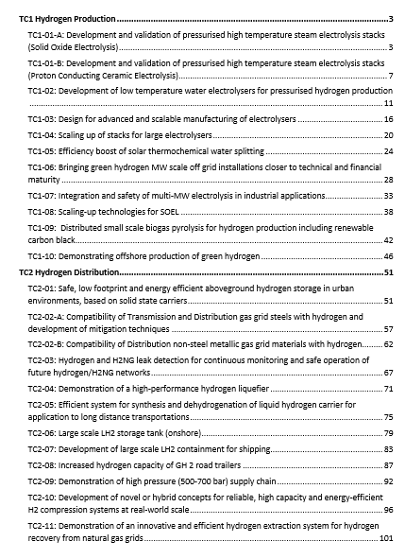
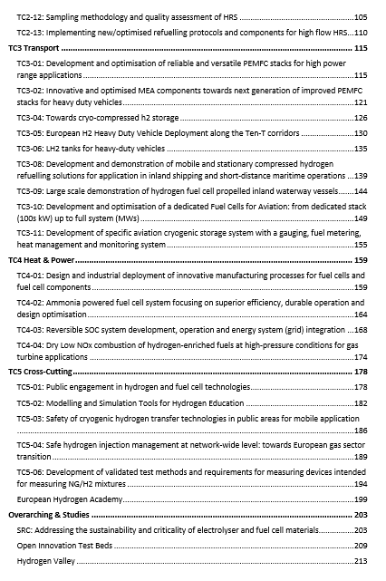
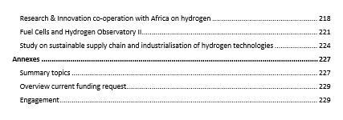
Numatomi 2022 metų šaukimai

